Slide 1

TECHNOLOGY PROJECT-GROUP 2
SPEECH ANALYSIS
SUBMITTED BY :
AMEYA PRASANNA MOTE - 3104966
KAUSHAL DABHI - 3105065
NANMA JOSEPH - 3104969
YASH SHETTY - 3104998

Slide 2

SPEECH ANALYSIS - ???
Analysing speech is the procedure by which the important information is extracted from the speech signals .
This method is mainly based on production mechanism which includes multiple linguistics and articulatory phonetics to signal processing and source coding .
Our project focuses on recognizing the speech produced by the speaker and also with their individual features are identified .

Slide 3

TARGET:
DETECTING SPEECH VERSUS SILENCE
RECOGNIZING MALE AND FEMALE SPEAKERS
TO PRESENT ANALYTICAL DATA FOR THE ANDROID GROUP TO DISPLAY

Slide 4
ABSTRACT:
Comparing speech with the text as medium of communication .
Speech recognition - technology allows machine to understand the words the speaker pronounces .
The most important part of speech recognition is to convert audio files into a 2X2 array .
Speech thus being a defined as most natural ,inuitive means for human communication which not only express the thoughts and feelings but also articulates sound gestures for communication purposes .
There are different forms of speech that can be categorized into various Dialects, Accents .
More advanced level of speech signal level exists in the form of: Amplitude variation, Duration, Pitch, Timbre .

Slide 5




ANALYSIS PROCESS FOR SPEECH :
1
Detecting voice : the segments of speech present in the waveform of audio are recognized whereas the silent segments and non-speech are neglected .
Enhancing the speech :increasing the quality of speech by removing the noise factor from the extracted segments .
Recognizing speech : the speech signals are transformed into text .
Identifying the speaker : The process often called "speaker dirization" which segments speech into different chunks which belong to different speakers .
Seperating audio source seperates overlapped or mixed speech from noise .
Speech modification: done by changing the emotion, tone and thus converting it to speech spoken by speaker .
classification of emotional speech : recognizing and identifying different emotions like happy, sad, angry and anxiety
spotting the keyword: detecting specific keywords in entire speech utterance .
Extracting the natural speech from the text and making it sound more natural with emotions .
2
3
4
5
6
7
8
9

Slide 6

DETECTING SPEECH V/S SILENCE :
Silence -> non perceptual audio signal
energy level contained in the silence is comparatively low .
Therefore an energy thresholding could extract the segments of silence.
There also exist different audio segments that can be classified as silence if the energy level is used alone, like low energy music .
There exists a ZCR(zero crossing rate) for silence which is comparatively low when compared to other audio types .
Hence by comparing the energy and ZCR, we can predict the improvement in accuracy of detecting silence .

Slide 7











RECOGNIZING MALE/FEMALE SPEAKERS:
Gender recognition – method by which gender of a speaker is determined by processing the speech signals
The Speech signals which is obtained from a recorded speech is used to acquire acoustic attributes such as
Duration
Intensity
frequency
filtering
Applications where gender recognitions are utilized are :
speech emotion recognition
human to machine interaction
sorting of telephone calls by gender categorization
automatic salutations
muting sounds for a gender and audio/video categorization with tagging .

Slide 8
RECOGNIZING MALE/FEMALE SPEAKERS:
Using this classification we can predict the gender of the speaker by using various voice parameters .
Speech signal carries 1) information for the communicator 2) contents information regarding the speaker .
The non-linguistic characteristic of the speaker provides help to differentiate male and female speaker.
The different features such as power spectrum density, frequency determined at maximum power carries the speaker details .
The features of the speaker could be tracked with frequency characteristic of vocal tract and also with the variation in excitation.
gender recognition can be classified based on two sub categories such as gender identification and gender verification.

Slide 9
RECOGNIZING MALE/FEMALE SPEAKERS:
With identification(1:N matching) a particular speaker is compared with database of N known speakers and the best match is returned as the decision for the recognition.
In the verification task involves making the decision whether the given sample of voice is produced from the claimed speaker.
Here when the unknown speaker voice sample is compared to the claimed speaker and if the similarity degree exceeds a particular threshold frequency then the speaker is accepted else the speaker is rejected.

Slide 10


INDUSTRY TRENDS THAT CREATE DEMAND FOR THE PRODUCT :
Market segment by type :
Voice recognition
Speech recognition
Market segment by application :
Competitive intelligence
Risk and compliance management
Others
Market segment by organization size
Banking, Financial Services, and Insurance
Retail and eCommerce
Travel and Hospitality
Government and Defense
Healthcare and Life Sciences
Energy and Utilities
Telecommunications and IT
Media and Entertainment
Travel and Hospitality
Others (Manufacturing, Real Estate, and Education)
Market segment by industry
Customer experience management
Call monitoring
Sales performance management
Agent performance monitoring
Large Enterprises
Small and Medium-sized Enterprises (SMEs)

Slide 11
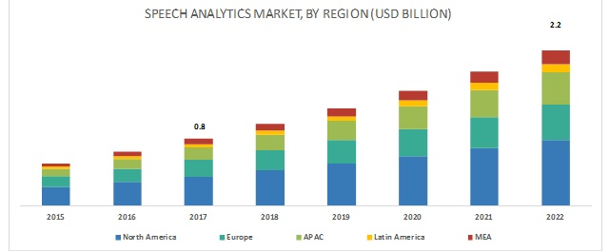
SAM/TAM :
Link : https://www.marketsandmarkets.com/Market-Reports/speech-analytics-market-17297779.html

Slide 12
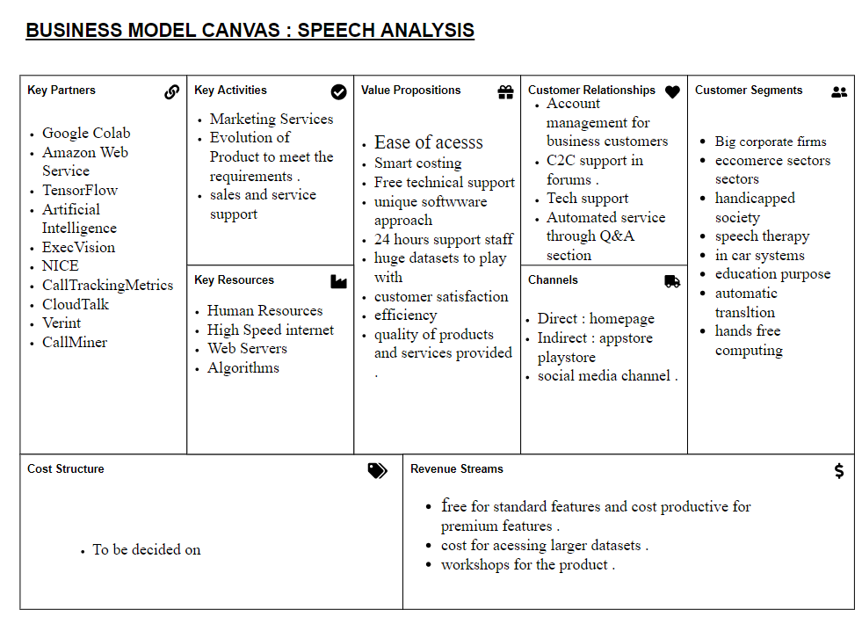

Slide 13
RISK ASSEMENT OF THE PRODUCT:
Low Risk : not able to meet the market deadline , no finished product .
Medium risk : :Incapability of handling large loads on the server of very few datasets to rely on.
High Risk: Less understanding of the product by the customers and as a result low sales due to less demands.

Slide 14

DATASETS:
Before we can classify gender based on voice, there must be a dataset that exists which contain relevant information.
Such dataset would help us in perceiving the difference between different genders easily.
Using R, we extracted features of a certain audio file .

Slide 15
DATASETS:
These features would be employed in our Machine Learning model to classify gender.
There are different way to classify gender and as such we chose to go with Mean, IQR and standard deviation etc. for classification as it a bit easy to understand.
The audio samples were collected from 5 male and 5 females.
The prediction results were mostly accurate but further samples would be needed to check the efficiency much better.
The audio was sampled at 16KHz at 16 bit rate.

Slide 16
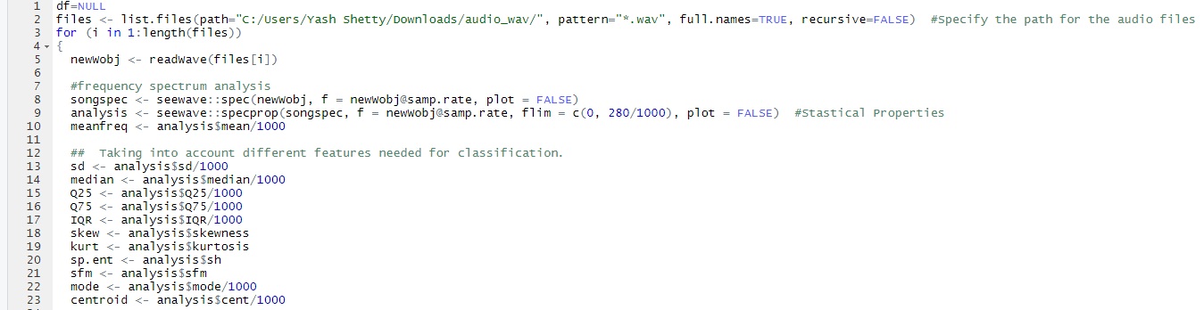
R CODE :
The first part of code is used to specify the file we want to process and different features we need to extract from it.
Second part involves analyzing the frequency using seewave .​
Third parts determines the mean ,median , standard deviation , mode etc. which are the features to be classified .​

Slide 17
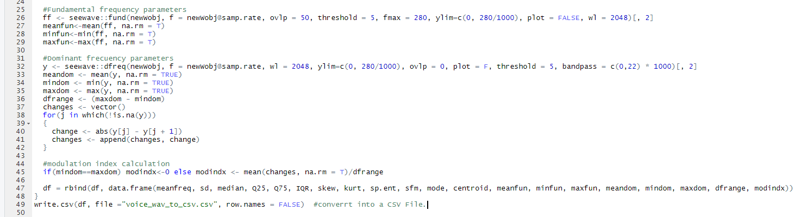
R CODE :
The 2nd part talks about churning out the specific fundamental frequency of the audio file and the dominant frequency of it .
It then converts the .wav File into a .CSV File.​
Calculating modulation index of the dataframe .

Slide 18
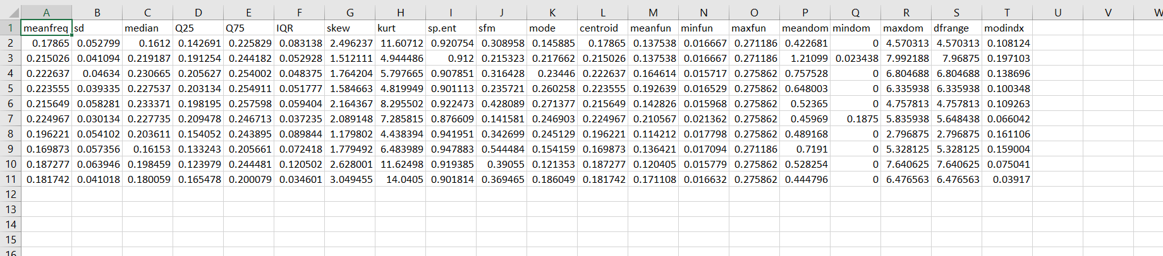
DATA FILE :

Slide 19
SUPPORT VECTOR MACHINE:
It is a type of supervised learning model which is used for both classification and regression problems.
It employs the help of kernels which help in transforming the features provided into suitable ones which could be used for decision boundary.
Since our number of features are more than the number of samples, SVM is a great fit for it.
SVM supports both linear and nonlinear classification .

Slide 20
SUPPORT VECTOR MACHINE:
It can clearly classify boundaries and are better than Logistic Regression due to margins present parallel to the decision boundary.
Apart from being a great fit, it is also memory efficient.
Relatively less effort for implementation .
Geometrically very clear working algorithm .
Can also be used for large feature rooms with lots of training data and training patterns.

Slide 21
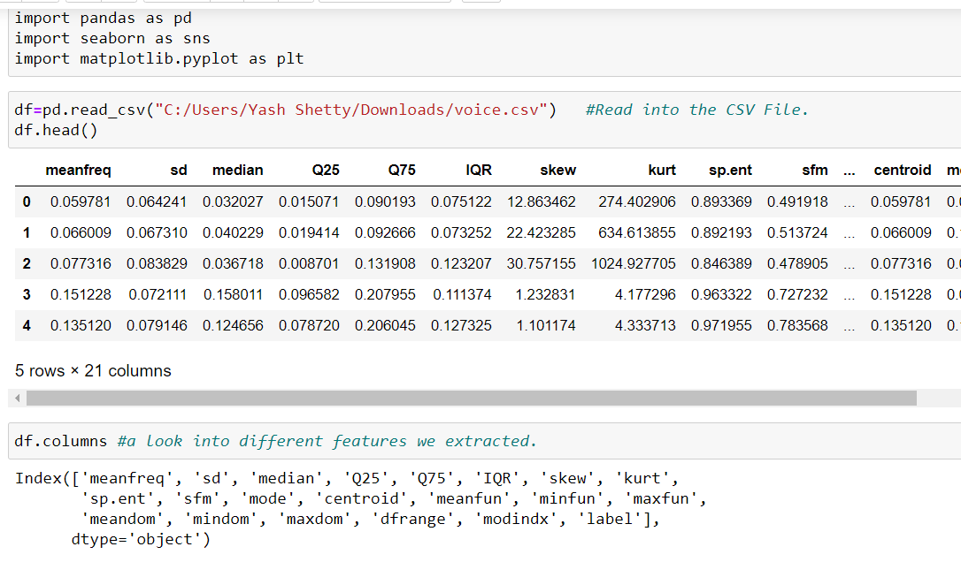
GENDER RECOGNITION :
Importing pandas, seaborn and matplotlib packages from the library
Reading into the csv file
It's a good practice to look at the data at have a good knowledge before starting any operation.
Determining different features that have been extracted

Slide 22
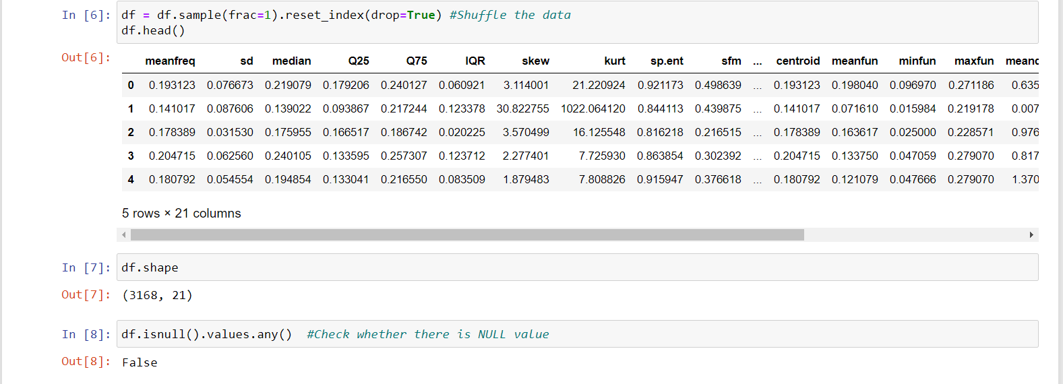
GENDER RECOGNITION :
Here we shuffle the data so that we can avoid Bias and that we can get accurate results.
This function is used to get a tuple representing the dimensionality of the data frame
Here we are checking whether if there are any null values

Slide 23
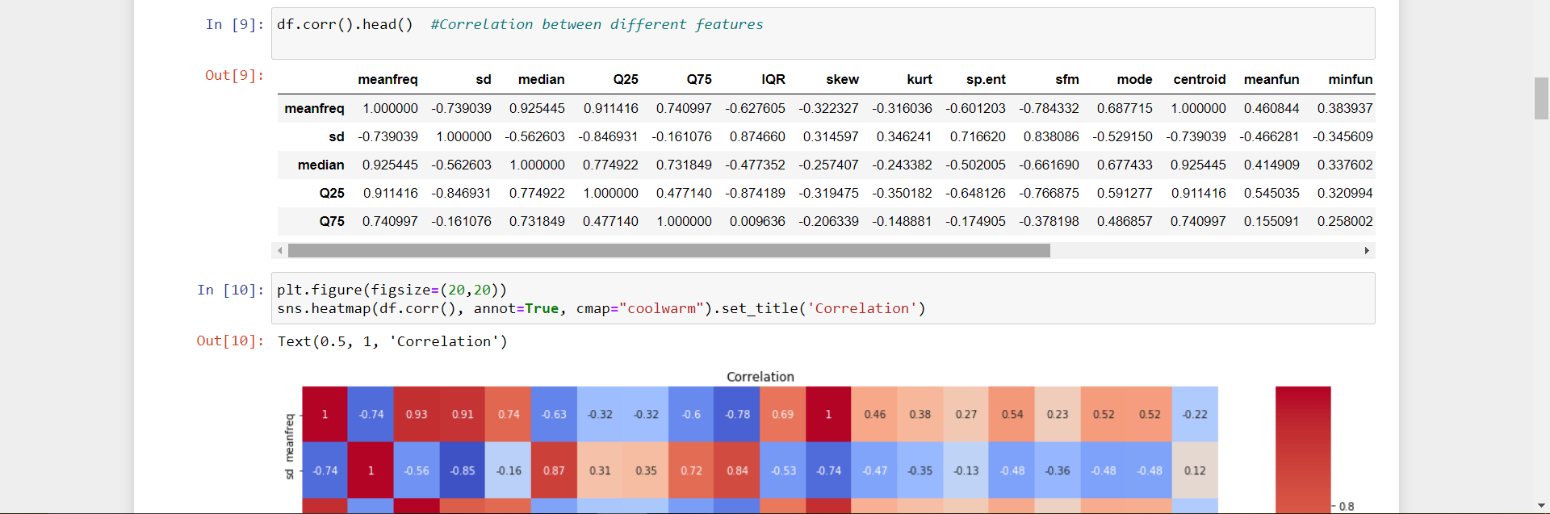
GENDER RECOGNITION :
This function helps to find the correlation among different features in the data frame .
Here we are plotting the figure
The heatmap function helps us in distinguishing different features easily

Slide 24
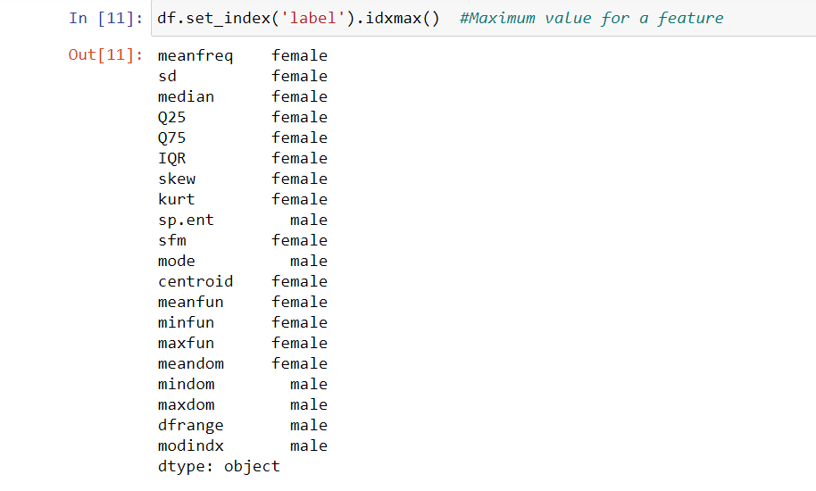
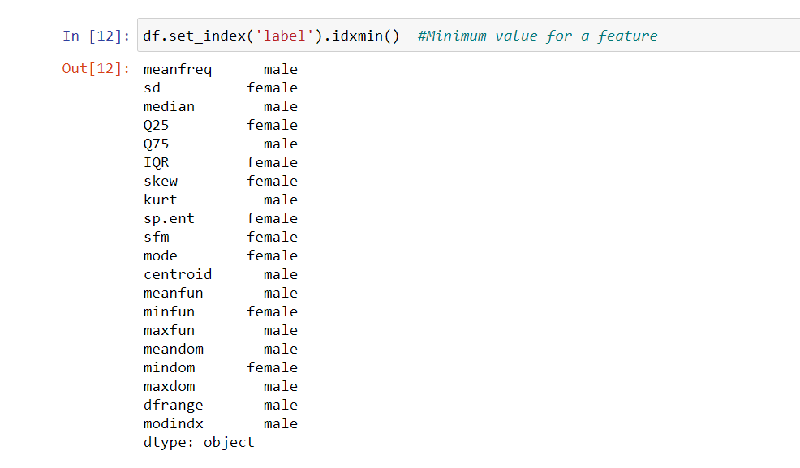
GENDER RECOGNITION :
Setting the 'Label' as the index and getting the maximum value of a feature.
Setting the 'Label' as the index and getting the minimum value of a feature.

Slide 25
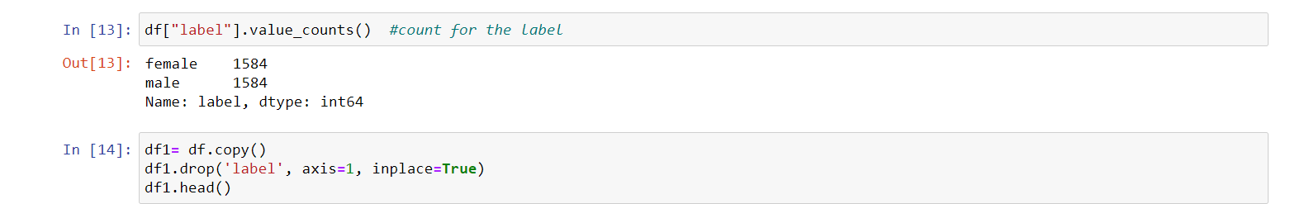
GENDER RECOGNITION :
Counting the total numbers of features available for selection for each classifier
copying the data into a new data frame. This is done to preserve the original dataset in case of any errors.

Slide 26
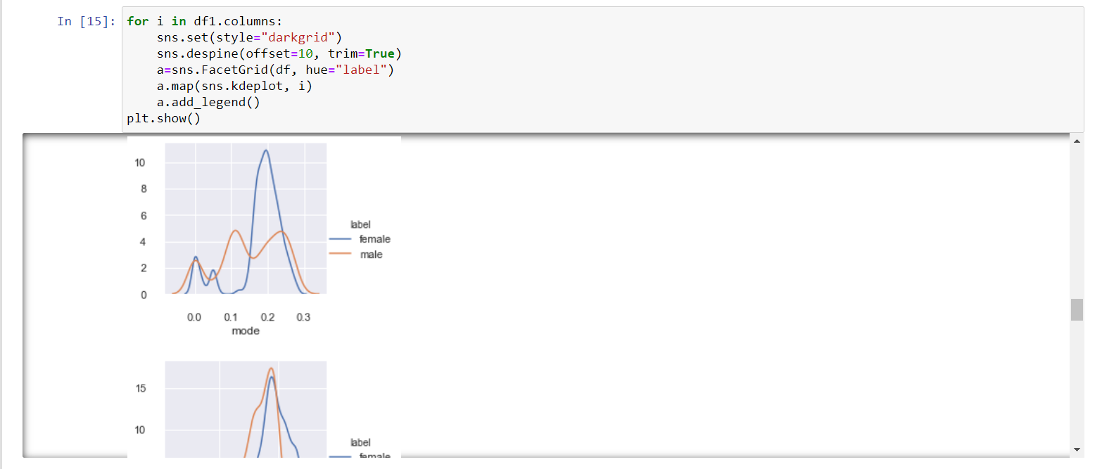
Visualizing the data using Seaborn. We can clearly see the variation in features for both genders.
GENDER RECOGNITION :

Slide 27
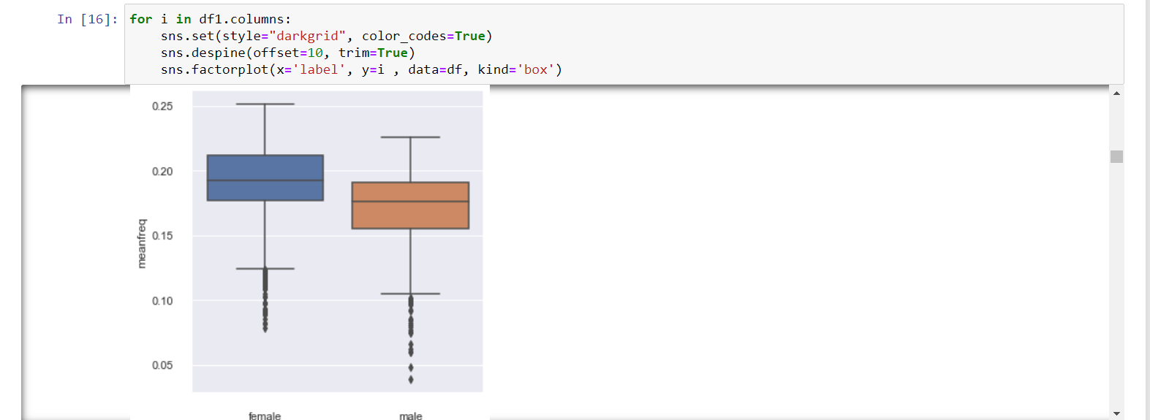
Using a box plot gives us a much better intuition and helps in better data visualization
GENDER RECOGNITION :
Offset determines theAbsolute distance, in points, spines should be moved away from the axes . A single value applies to all spines
If trim equals True, limit spines to the smallest and largest major tick on each non-despined axis

Slide 28
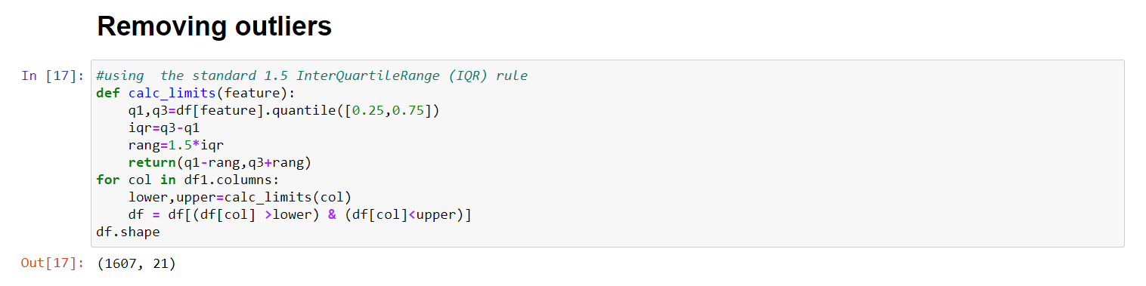
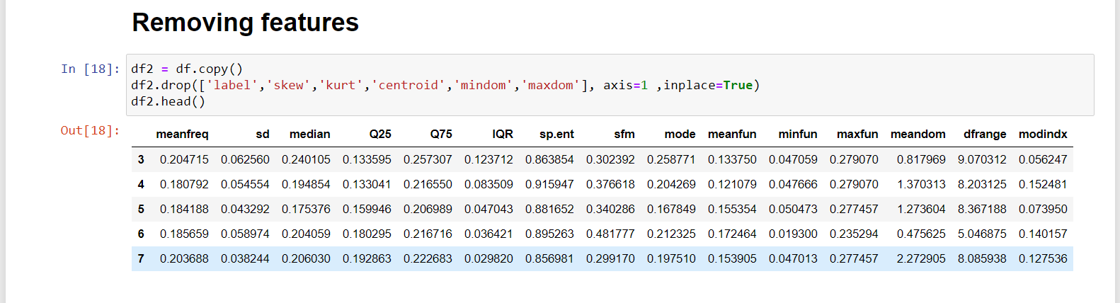
Removing outliers helps in reducing skewness and then remove the extra features that have no relevant effect on the output.
GENDER RECOGNITION :
Removing the features using drop function

Slide 29
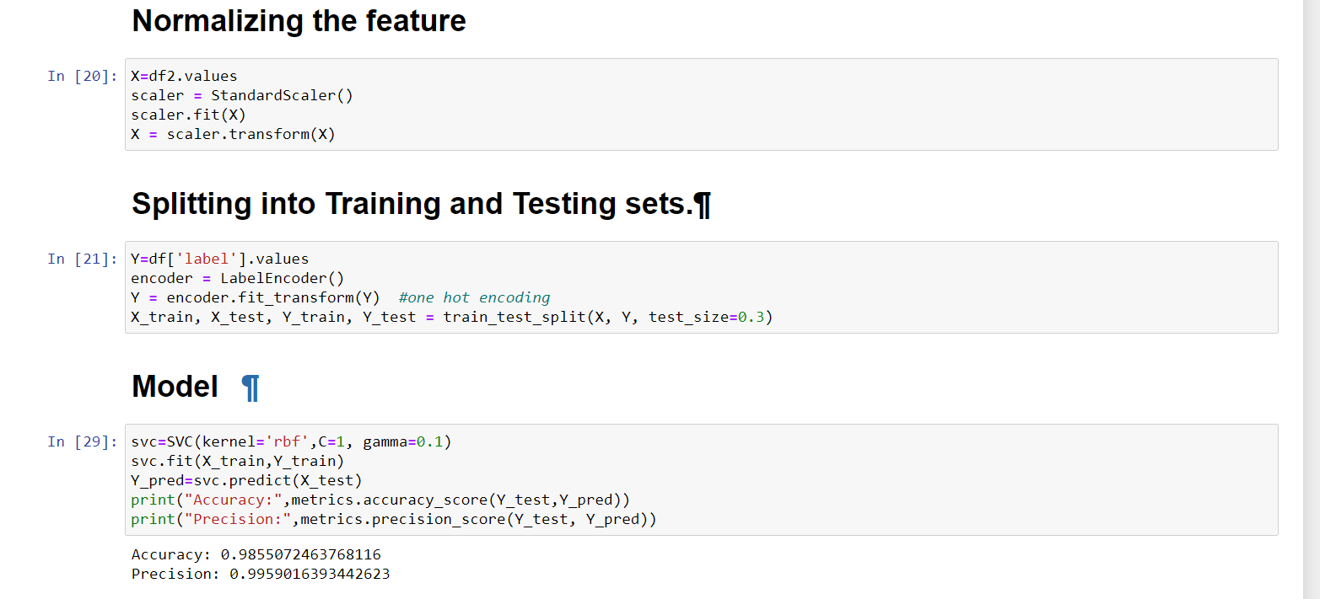
Normalizing the features helps in having same range of values. Use Train_Test_Split to avoice BIAS and have some unknown data to work with.
GENDER RECOGNITION :
We use Support Vector Machine for this classification.This helps to determine accuracy and precision of the training set ​

Slide 30
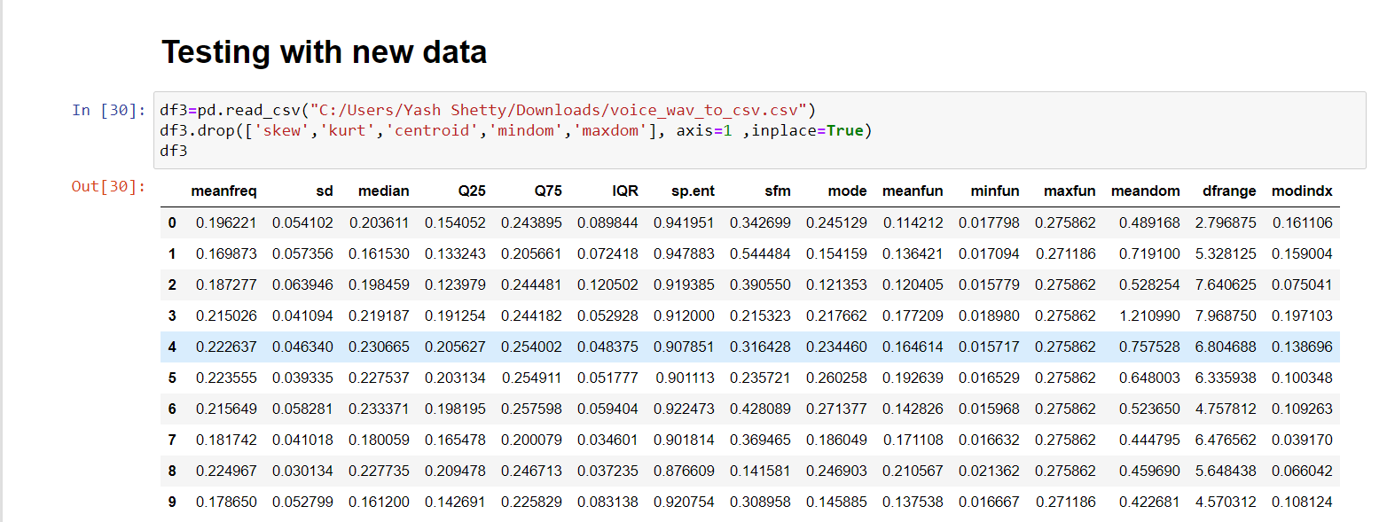
Testing our model on unknown data to get the prediction.
GENDER RECOGNITION :

Slide 31
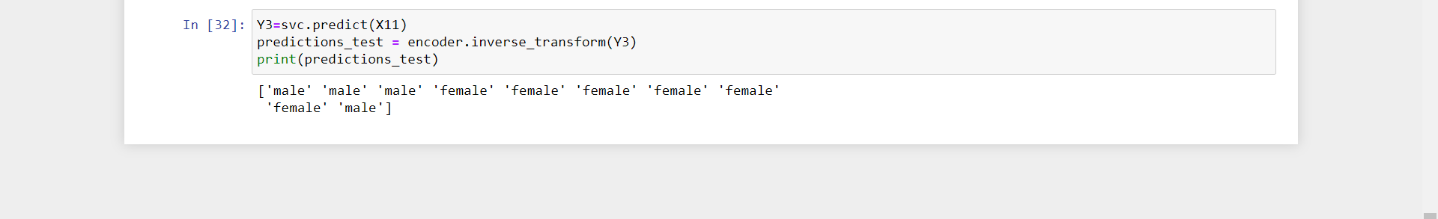
Here we are getting the desired output except one Audio File being misclassified.
GENDER RECOGNITION :

Slide 32
REFERENCES :
https://www.researchgate.net/publication/325554736_Speech_synthesis_systems_Disadvantages_and_limitations
http://jorgenboge.wikidot.com/how-to-analyze-a-speech
https://www.marketsandmarkets.com/Market-Reports/speech-analytics-market-17297779.html
http://www.ub.edu/lexdialgramarxius/theapplicationofspeech.pdf
https://medium.com/@TEAM.BULLS/application-of-speech-recognition-technology-in-speech-related-disabilities-an-analysis-and-5b102da57f86
https://search.slidegeeks.com/search?af=cat1%3apowerpointtemplates&lbc=slidegeeks&method=and&p=Q&ts=custom&w=roadmap&cnt=200
https://www.bigdata-insider.de/was-ist-eine-support-vector-machine-a-880134/

Slide 33

THANK YOU

